Slide 1



Please use one for every lesson throughout the week.
Use as a quick discussion at the start of the lesson.
Period 5 and all-day Friday is based around reading.

Slide 2


Monday period 1
If you do use E-Cigarettes – think about how much it is costing?
What could you buy with that money?

Slide 3
Monday period 2
If you do use E-Cigarettes use a plan to help you quit.
Start with – by which date do you want to stop?

Slide 4

Monday period 3
If you do use E-Cigarettes think about why you should stop vaping.
Health benefits?

Slide 5
Monday period 4
If you do use E-Cigarettes think about, why do you vape?
What are the triggers?
Boredom?
Peer pressure?

Slide 6

Monday period 5
Some people have suggested that use of e-cigarettes by young people might "protect" them from using cigarettes. There is no evidence to support this claim. Some studies show that non-smoking youth who use e-cigarettes are more likely to try conventional cigarettes in the future than non-smoking youth who do not use e-cigarettes. And among high school students and young adults who use two or more tobacco products, a majority use both e-cigarettes and burned tobacco products.

Slide 7
Tuesday period 1
Why do you think vaping is so addictive?
How could you replace the need?

Slide 8
Tuesday period 2
Why do you think vaping is linked to peer pressure?

Slide 9
Tuesday period 3
Why do you think vaping makes concentrating difficult?

Slide 10
Tuesday period 4
Why do you think vaping makes managing emotions difficult?

Slide 11
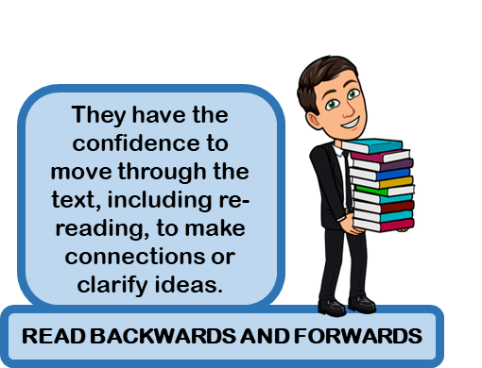
Tuesday period 5
Scientists are still working to understand more fully the health effects and harmful doses of e-cigarette contents when they are heated and turned into an aerosol, both for active users who inhale from a device and for those who are exposed to the aerosol second-hand. Another risk to consider involves defective e-cigarette batteries that have been known to cause fires and explosions, some of which have resulted in serious injuries. Most of the explosions happened when the e-cigarette batteries were being charged.

Slide 12
Wednesday period 1
When you are trying to quit:
Ask for help from a professional – GP or health practioners

Slide 13
Wednesday period 2
When you are trying to quit:
Stay hydrated – drink plenty of water

Slide 14
Wednesday period 3
When you are trying to quit:
Get plenty of sleep

Slide 15
Wednesday period 4
When you are trying to quit:
Eat healthily and get plenty of exercise

Slide 16
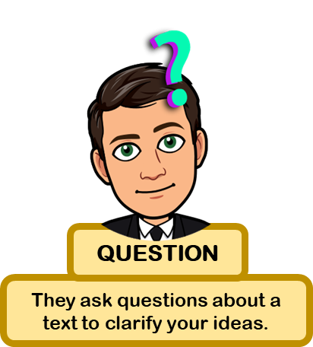
Wednesday period 5
SMOKING VS VAPING Smoking is much more harmful than vaping. Tobacco smoke contains carbon monoxide and tar, a sticky soup of around 250 toxic chemicals, 69 of which are known to be carcinogenic, causing disease, disability, and early death. HOWEVER, VAPES ARE NOT HARMLESS Short-term effects can include: • coughing • headaches • dizziness, and • sore throats. Long-term effects are, as yet, unknown.

Slide 17
Thursday period 1
Managing stress – which leads to vaping:
Stop and breathe
Pause what you are doing, and take a deep breath in through your nose and out through your mouth.

Slide 18
Thursday period 2
Managing stress – which leads to vaping:
Learn your anxiety triggers
Think about what makes you anxious

Slide 19
Thursday period 3
Managing stress – which leads to vaping:
Move!
Exercise – even a quick walk outside can help de- stress

Slide 20
Thursday period 4
Managing stress – which leads to vaping:
Accept that life will bring ups and downs and try to see that vaping will not help that in anyway.

Slide 21
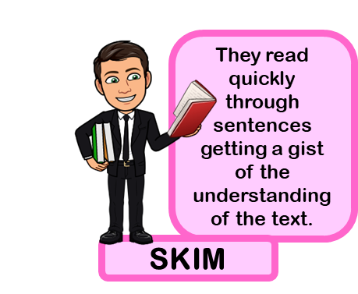
Thursday period 5
THE LAW AND VAPING Vapes and vaping products containing nicotine, like tobacco, are age restricted. It’s illegal to sell them to under 18s, and for adults to buy them on their behalf. If you know of anyone who does sell vapes or tobacco illegally, you can report them to trading standards through the Citizens Advice online portal: citizensadvice.org.uk/consumer

Slide 22
Friday period 1
Most e-cigarettes also contain nicotine. Nicotine is very addictive and can harm brain development, which continues past adolescence into the mid-20s.

Slide 23
Friday period 2
Besides nicotine, e-cigarettes can contain harmful and potentially harmful ingredients, including:
ultrafine particles that can be inhaled deep into the lungs

Slide 24
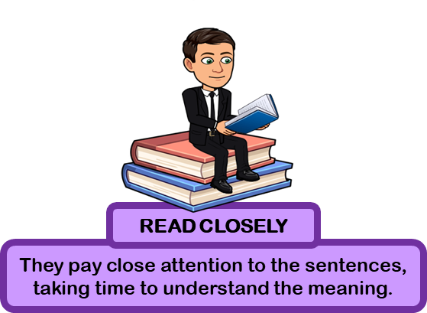
Friday period 3
Besides nicotine, e-cigarettes can contain harmful and potentially harmful ingredients, including:
flavourants such as diacetyl, a chemical linked to serious lung disease
volatile organic compounds
heavy metals, such as nickel, tin, and lead

Slide 25
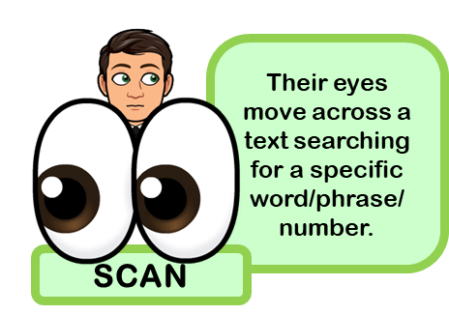
Friday period 4
The part of the brain that's responsible for decision making and impulse control is not yet fully developed during adolescence. Young people are more likely to take risks with their health and safety, including use of nicotine and other drugs.
Youth and young adults are also uniquely at risk for long-term, long-lasting effects of exposing their developing brains to nicotine. These risks include nicotine addiction, mood disorders, and permanent lowering of impulse control.
Nicotine also changes the way synapses are formed, which can harm the parts of the brain that control attention and learning.

Slide 26
Friday period 5
Until about age 25, the brain is still growing. Each time a new memory is created, or a new skill is learned, stronger connections – or synapses – are built between brain cells. Young people's brains build synapses faster than adult brains.
Because addiction is a form of learning, adolescents can get addicted more easily than adults. The nicotine in e-cigarettes and other tobacco products can also prime the adolescent brain for addiction to other drugs such as cocaine.

