Slide 1


Anti Vaping Week
Assembly
The British Value we are looking in today’s assembly is:
Individual liberty
Making the right choices linked to health and wellbeing

Slide 2



Reminder week 2
Sexual harassment
Physical acts of sexual assault.
Upskirting
Verbal harassment of a sexual nature, including jokes referring to sexual acts or sexual orientation.
Unwanted touching or physical contact.
Unwelcome sexual advances.
Discussing sexual relations/stories/fantasies at work, school, or in other inappropriate places.
Feeling pressured to engage with someone sexually.
Unwanted sexually explicit photos, emails, or text messages.

Slide 3

You may have noticed we are talking about the dangers of vaping this week!
Why??
Because the number of young people vaping across the country is rising
Because we are worried about your long-term health
Because we want to the toilets to be free from vape smoke
Because we do not want you to become addicted

Slide 4
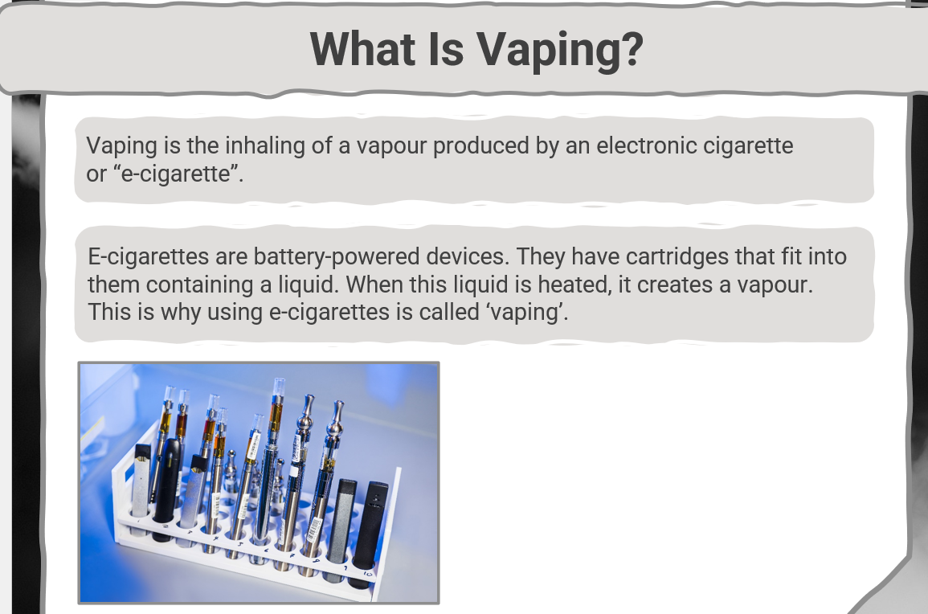


Slide 5



Why Are E-cigarettes So Popular?
E-cigarettes were sold in the UK around 2007 and have gained popularity since then. Cigarettes produce many chemicals that can have extremely harmful effects on smokers and those around them. E-cigarettes do not produce tar or carbon monoxide: two of the most harmful elements found in cigarettes. Because of this, many adults who want to give up smoking cigarettes choose vaping as a ‘less damaging’ alternative.
Did You Know…?
E-cigarettes are battery-powered devices. They have cartridges that fit into them containing a liquid. When this liquid is heated, it creates a vapour. This is why using e-cigarettes is called ‘vaping’.

Slide 6
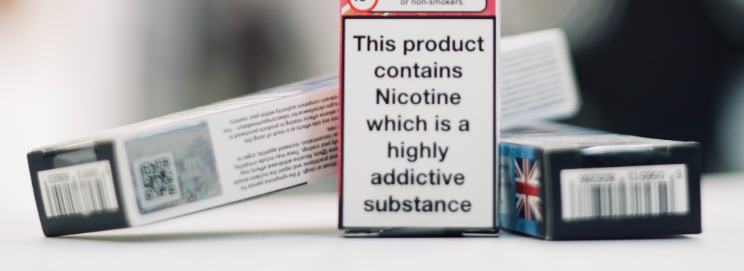
What’s Inside an E-cigarette Cartridge?
E-cigarette cartridges are known to include:
nicotine, a stimulant drug that speeds up the messages travelling between the brain and the body;
propylene glycol, used to make antifreeze, paint and artificial smoke in fog machines;
flavourings to produce the different scents that the vapour has.

Slide 7

Regulation
In 2016, strict laws were passed by the UK government regulating the ingredients in the cartridges of an e-cigarette. However, in other countries, cartridges are not made with the same scrutiny and therefore dangerous chemicals can be included.
There are many alarming news articles about people who have died after vaping, but these refer to people who chose to mix other drugs with their cartridges, resulting in an extreme effect.

Slide 8
Is Vaping Safe? No!
It is important to remember that vaping is for adults who are aged 18 and over. E-cigarettes contain nicotine, which is an incredibly addictive substance. You should never be given an E –cigarette by an adult.
Nicotine affects everyone differently, based on:
size, weight and health;
whether the person is used to taking it;
the amount taken.
Nicotine can slow brain development in children and teenagers and affect learning, memory and concentration. This stimulating drug can remain in the body for up to three days, depending on your genetic makeup, so as it disappears, people who are addicted to nicotine will find themselves craving more. If they don’t obtain more nicotine, many people experience irritability, trouble concentrating and restless sleep.

Slide 9

What Would You Do?
Your friend comes to school with her mum’s e-cigarette. She invites you to try it in the toilets with her. She says that it’s a great thing because it helped her mum give up smoking cigarettes.
Remember that e-cigarettes have been effective in helping many adults stop smoking cigarettes, but it is still illegal for children under the age of 18 to vape.
The toilets are the biggest problem in schools across the UK. Students are vaping in the toilets which is by law not allowed. Also, other students feel intimated by this behaviour and do not want to use the school toilets – which is unfair.

Slide 10
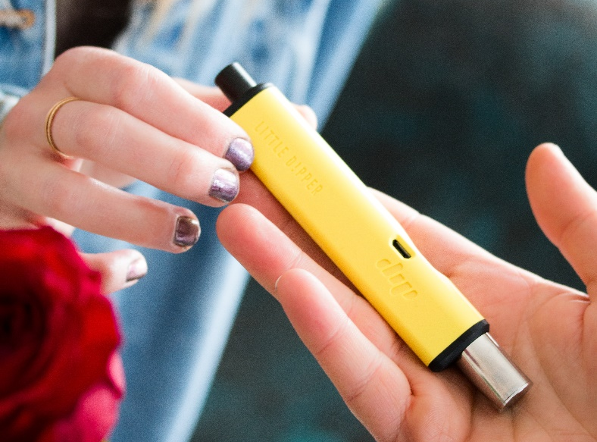

What Do You Think?
Studies have shown that young people who vape are more likely to try other drugs and cigarettes and are more likely to become addicted to other substances later in life.
Young people who start using addictive substances get used to experimenting with other drugs, so it becomes a habit.
It’s best not to start at all.

Slide 11

What Would You Do?
You find your little sister playing with an e-cigarette cartridge. She is trying to break it open and try it because she knows that it smells like strawberry which are her favourite fruit.
The liquid inside e-cigarette cartridges is extremely dangerous for children to ingest. If you believe that your sister has swallowed any of it, you must tell a trusted adult immediately and seek medical advice as soon as possible.

Slide 12

What does this mean for you?
Hand in any vapes you might have to your year team – no questions asked
Aim to stop using your vape – you will regret it later in life
Ask for support in stopping vaping – see year team or support websites on Facebook
Give your name into the ‘Support with Vaping’ box in the library
Speak to a trusted adult
If this is not possible then limit vaping to away from the school building - smoking is not allowed in the school building or any covered areas
Think about how anti-social you are being by vaping in the toilets
If you do not vape at all – try and be the eyes on the ground – vaping will be punished and is not tolerated
Think about what I have said.

Slide 13
Photos from the week
Notes:
This will be found in Shannon email weekly – emphasis on Post 16

Slide 14

Strength of Character – WOW Wednesday

Slide 15
Year group information – add slides

Slide 16

Reflection – Big question
Think about the health risks of vaping and the cost.

